Slide 1

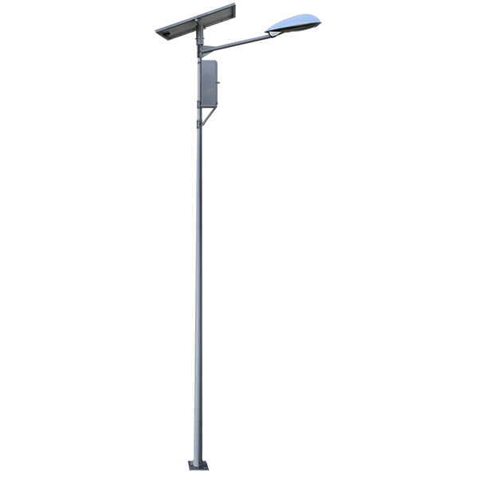
LAMPIONE
For Brighter Future
Centralized Monitoring System For Street Light Fault Detection and Location Tracking

Slide 2
Team Member Details
Team Leader Name: M BARATH KUMAR
Branch : BE Stream : EEE Year : III
Team Member 1 Name: KARTHIK S L
Branch : BE Stream : EEE Year : III
Team Member 2 Name: RAMPAVITHRAN RP
Branch : B.Tech Stream : IT Year : III
Team Member 3 Name: NITHISH F R
Branch : B.tech Stream : IT Year : III
Team Mentor 1 Name: Ms. S. SHEEBA RACHEL (Assistant Professor , IT , Sri Sairam Engineering College)
Category : Academic Expertise : AI, Deep Learning Domain Experience : 13 Years
Team Mentor 2 Name: Mr. J. JOHN PRATAP SINGH (Piping Manager, L&T Energy Hydrocarbon)
Category : Industry Expertise : AI, ML Domain Experience : 18 Years

Slide 3
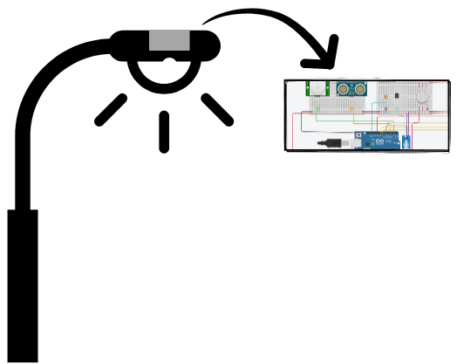
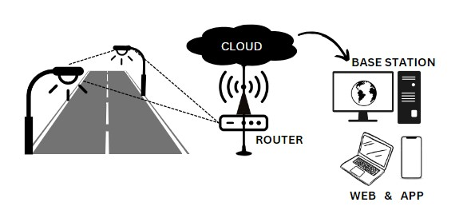
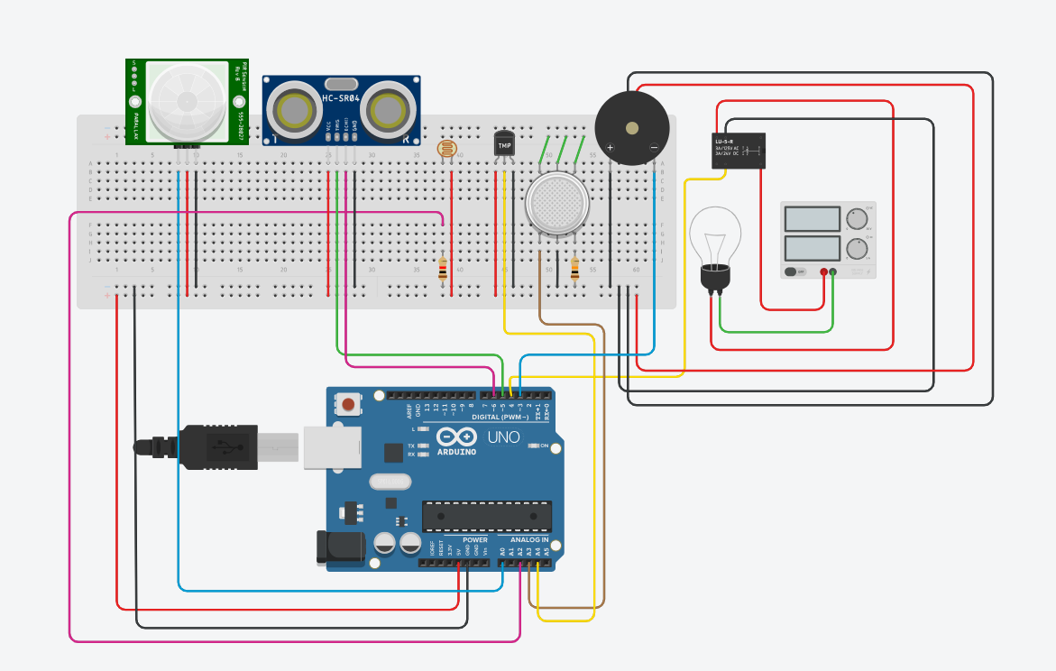
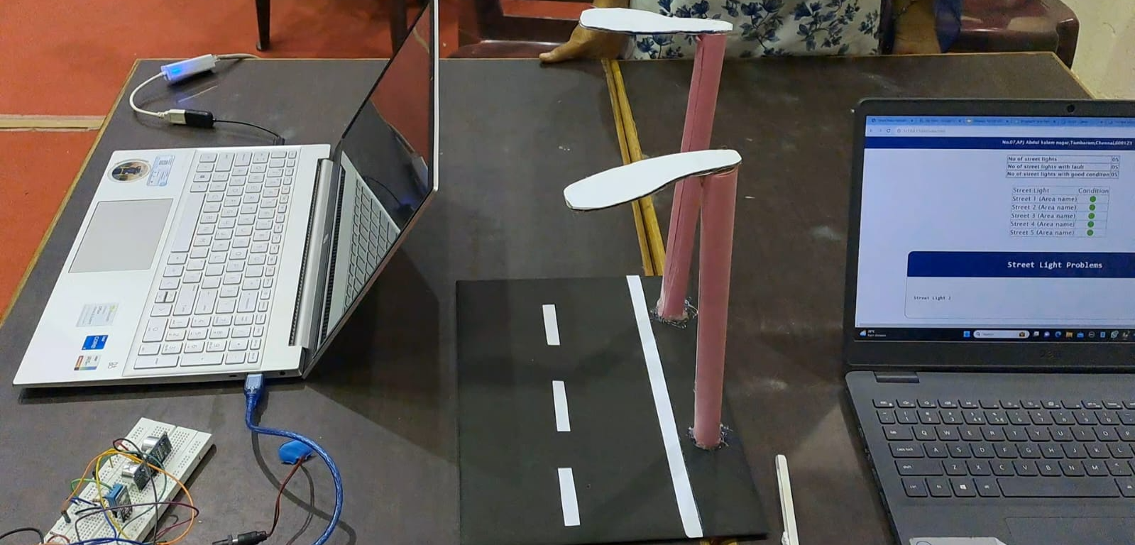
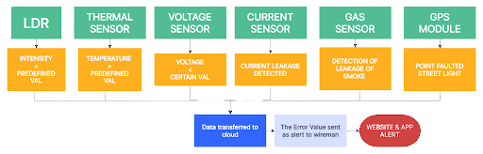
IDEA APPROACH :
HARDWARE CIRCUIT
Street Light 2
Increasing street light faults due to higher numbers.
Developing an automated fault detection system.
Hardware includes sensors (LDR, motion, thermal, voltage, gas) and microcontrollers.
Sensors identify faulty lights and send reports with GPS location.
App detects faulty lights, provides defect details.
Reports sent to EB personnel for quick repairs.
Module
Street Light
Street Light 1
INTERNAL
WORKING
TARGET ENVIRONMENT SETUP
PROJECT SETUP
COMPLETION STATUS
85%
PROJECT LINK : https://drive.google.com/file/d/1jCDarqossgmHzJ9pG2GggliwUuajGyet/view?usp=sharing
WORKFLOW DIAGRAM
TECH STACK
HARDWARE
Thermal Sensor
LDR
Current Sensor
Earth Leakage Relay
Flame Sensor
GPS Module
SOFTWARE
Firebase
Visual Studio
Arduino Cloud

Slide 4
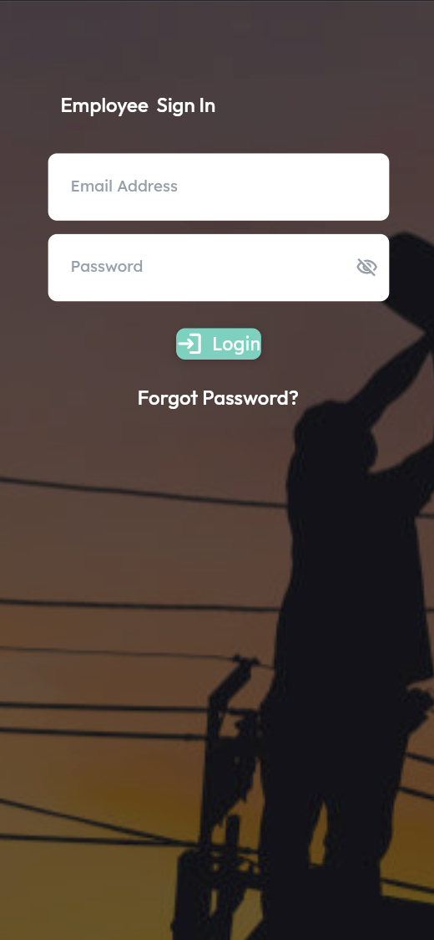
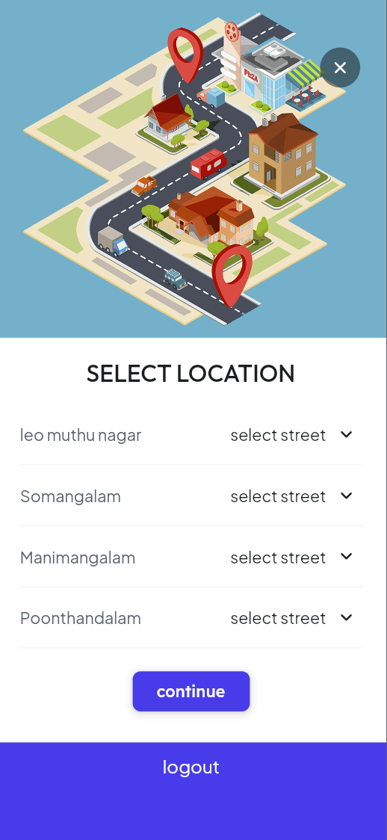
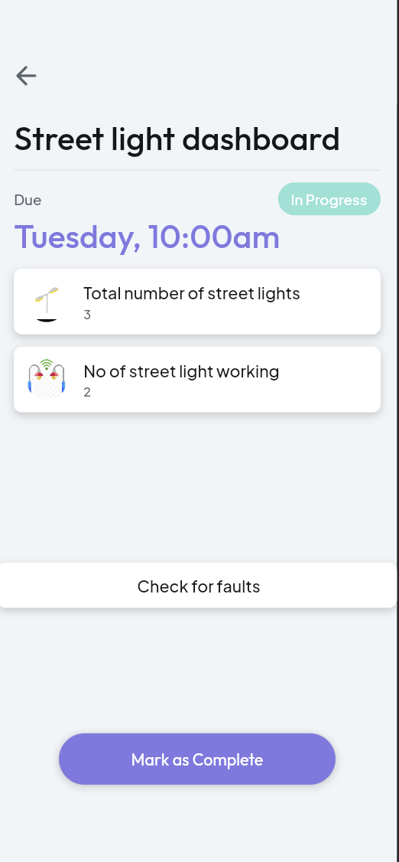
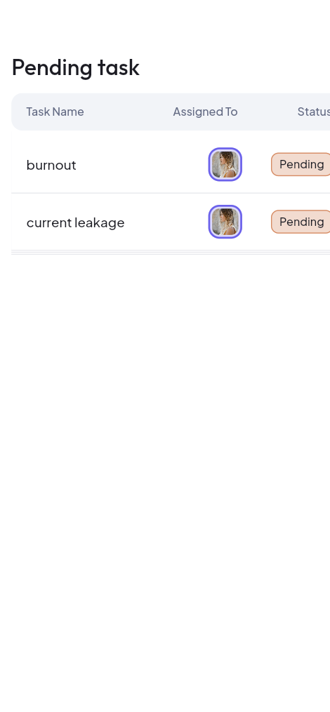
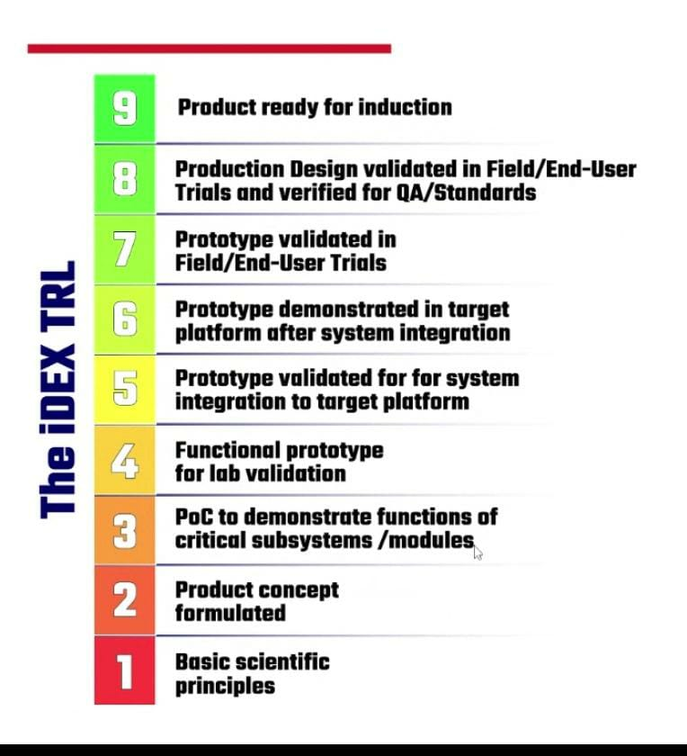
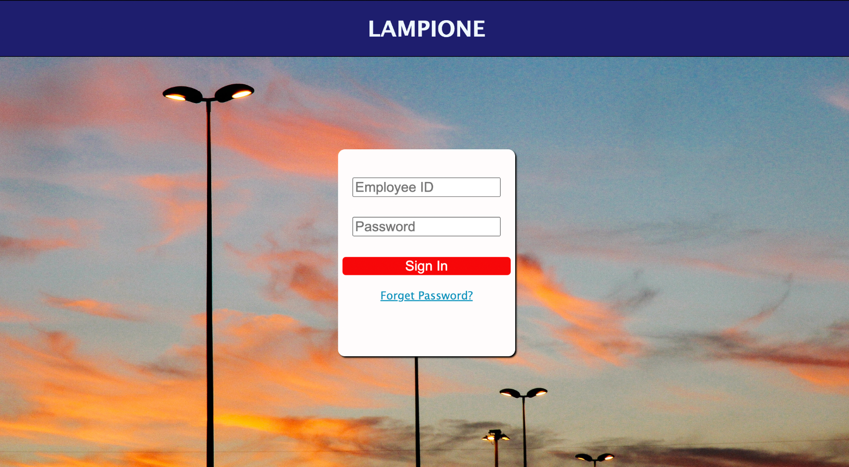
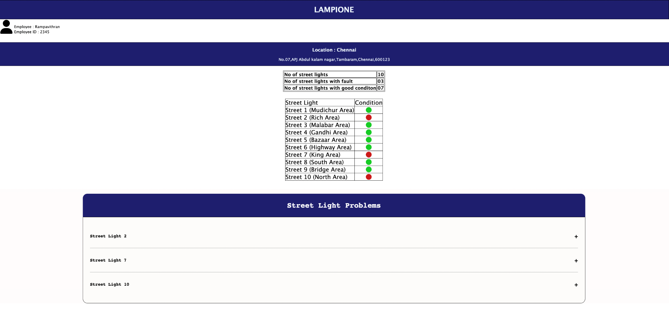
LAMPIONE APPLICATION
TECHNOLOGY READINESS LEVEL
USE CASE
In Non functioning of lights
In Current Leakage
In Cable Breakage
For Street Lights in rural and urban areas
DEPENDENCIES
Electrical sensors
Power source
Android application
Location detection
Data Management
HARDWARE BRIEF :
LAMPIONE Hardware comprises of an Arduino UNO Wifi Module which acts as the CPU of the system. It senses the Street light Fault & location of the defected light through LDR,GPS MODULE, THERMAL SENSOR, VOLTAGE SENSOR, GAS SENSOR. All the sensed data are transferred to the Database through NodeMCU ESP8266 module in Arduino. They can be monitored through the LAMPIONE-Website by the authorities & also by the Public through LAMPIONE-APP.
SOFTWARE BRIEF :
LAMPIONE has dual monitoring site specifically designed for monitoring and detecting defect in street light . The website is made for the AUTHORITY and the application for the public to view the status of the defective street light and to raise questions.The APP as well as the website as a time duration of 96 hrs to repair the street light & they also specifies the type of defect
SHOW STOPPERS
Weak Internet connections
Bugs (Minor)
COMPONENTS
LDR
Voltage sensor
Thermal sensor
current Sensor
Gas Sensor
Motion Sensor
GPS Module
WEB APPLICATION INTERFACE

